Slide 1
Members Survey
2013

Slide 2
Members Survey
2013
City of Greater Dandenong
Neighbourhood Houses
Community Contributions & Impacts

Slide 3
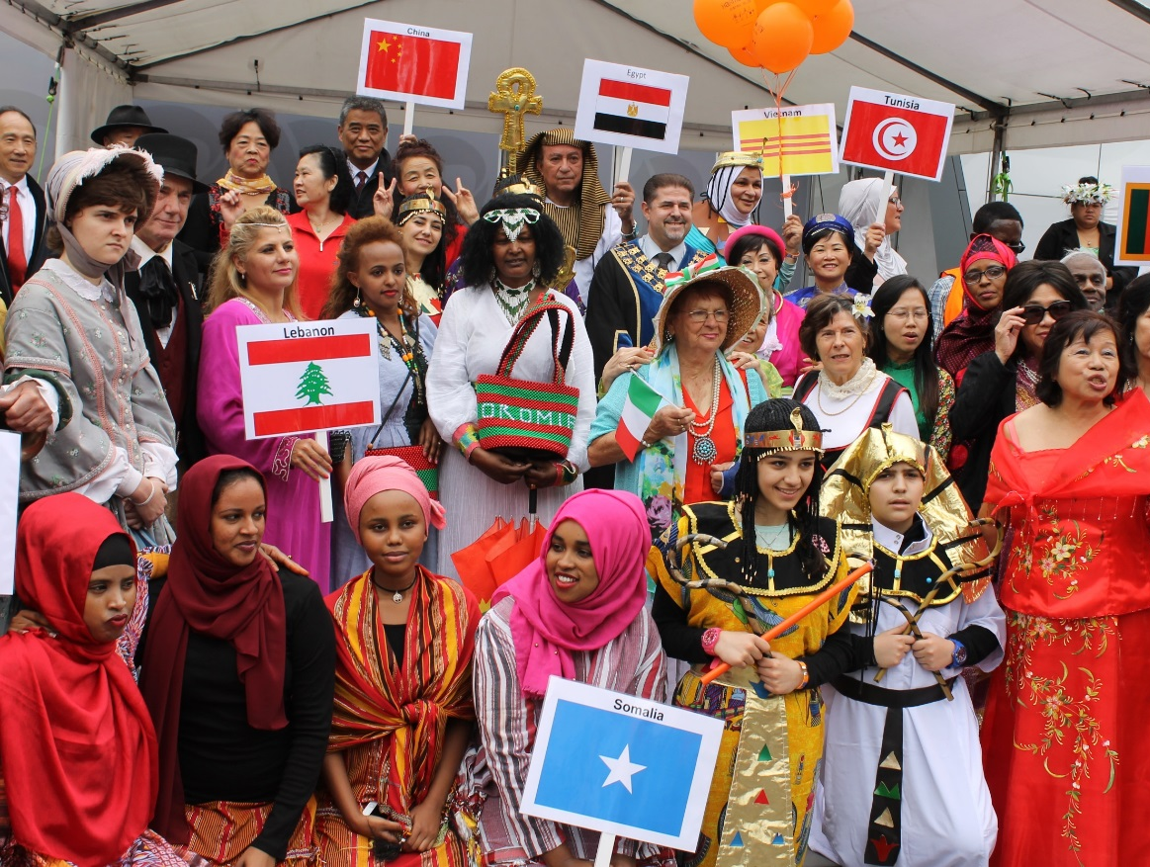
Summary of key highlights and trends

Slide 4
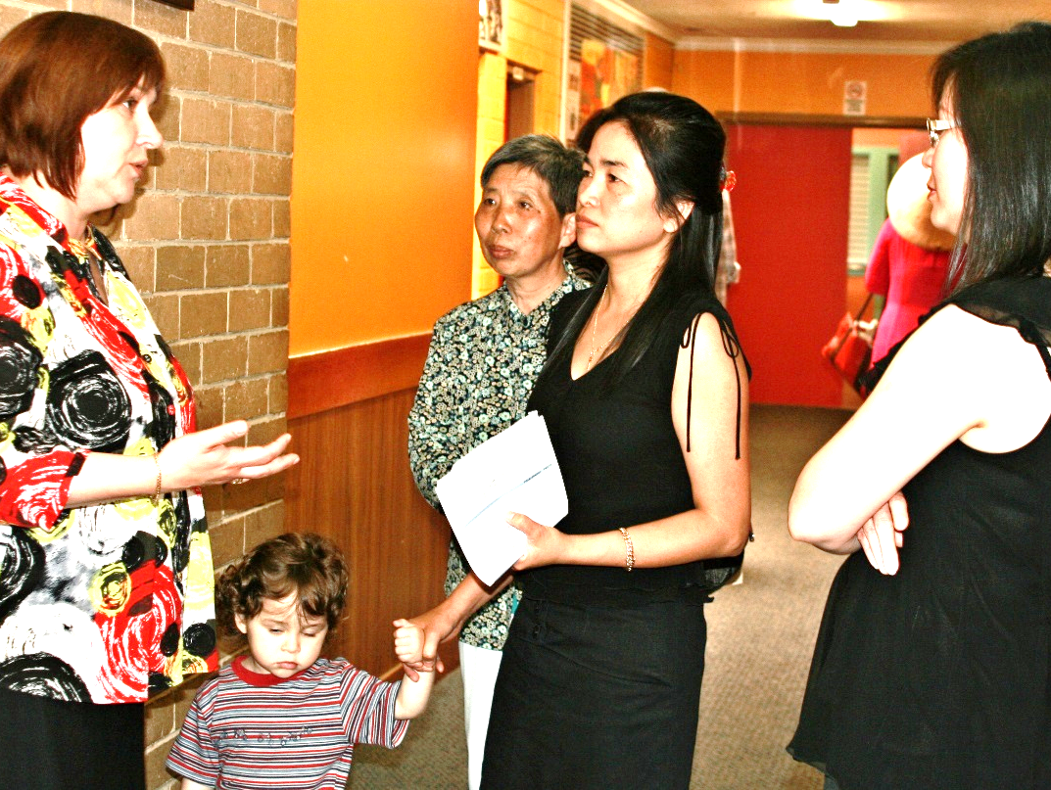
Visitors
people
visit City of Greater Dandenong Neighbourhood Houses
each week
6960
Notes:
The data collected through the Neighbourhood House Survey should be inserted into this slide.

Slide 5
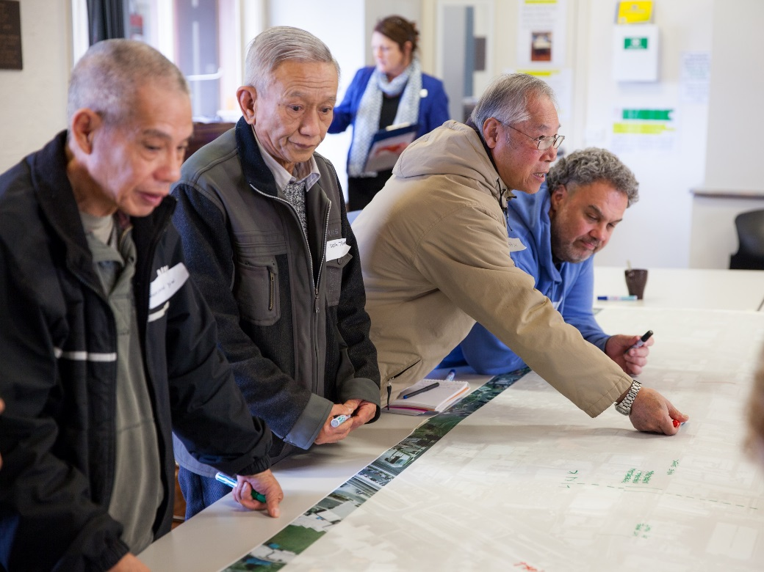
Participation
people
participate in programmed activities at CoGD Neighbourhood Houses
each week
4242
Notes:
The data collected through the Neighbourhood House Survey should be inserted into this slide.

Slide 6
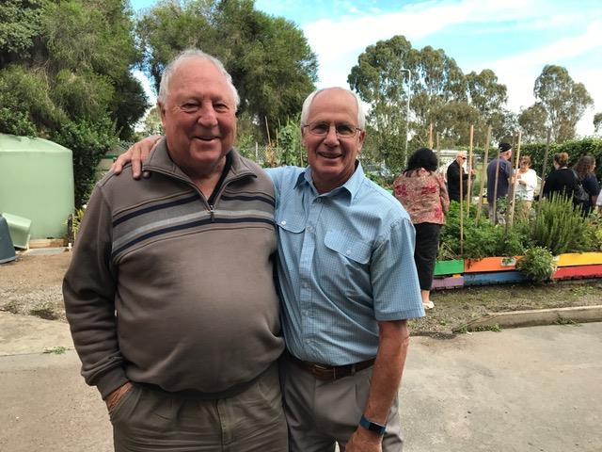
Volunteers
32
people
volunteer at City of Greater Dandenong Neighbourhood Houses each week
320
$1,350,272
per year
This equates to 48,224 hours of volunteers per year valued at:
Notes:
The data collected through the Neighbourhood House Survey should be inserted into this slide.

Slide 7
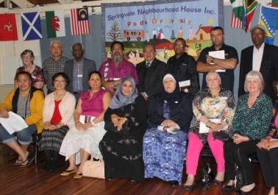
Governance
CoGD Neighbourhood House Committees contributed more than
hours per
month on
committee business
305
That’s the annual equivalent of
2 people working fulltime on governance
for City of Greater Dandenong communities
Notes:
The data collected through the Neighbourhood House Survey should be inserted into this slide.

Slide 8
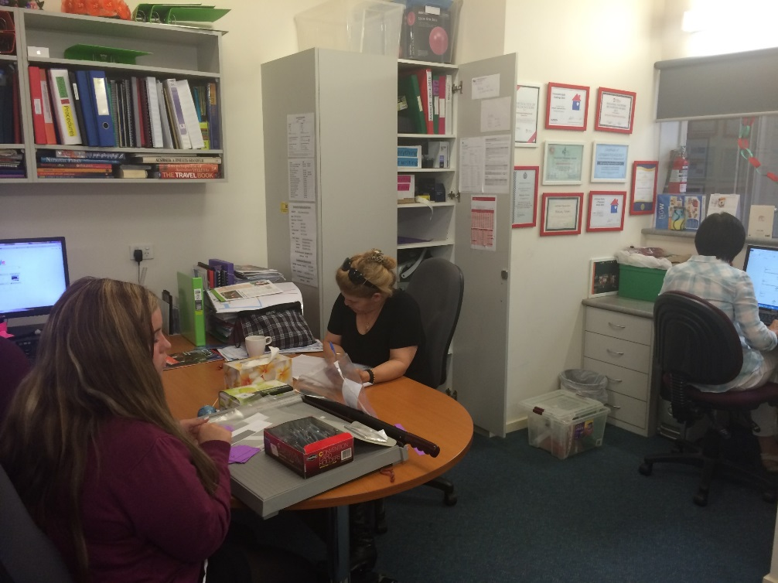
Employment
people
are employed by Neighbourhood Houses in the City of Greater Dandenong
87
Notes:
The data collected through the Neighbourhood House Survey should be inserted into this slide.

Slide 9
Income Leveraging
In 2016 every $1 invested by City of Greater Dandenong through N’House Coordination Grants, Neighbourhood Houses, raised an additional
$9.50
Notes:
The data collected through the Neighbourhood House Survey should be inserted into this slide.

Slide 10
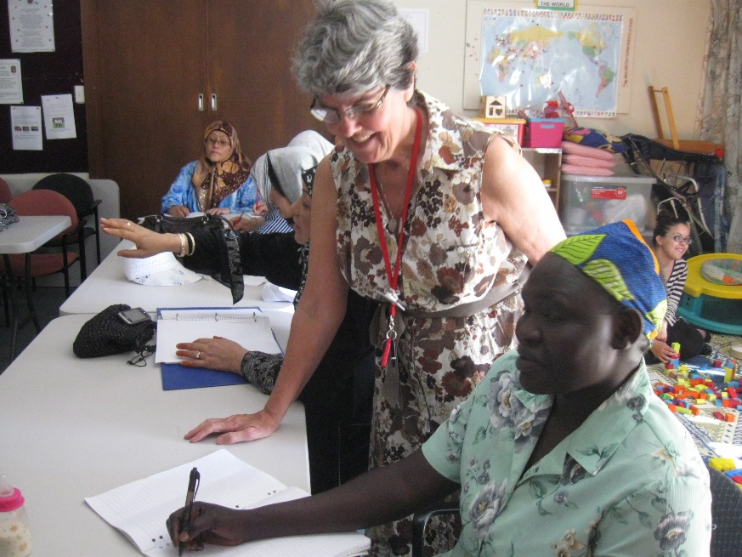
Programs & activities
Main programs run at City of Greater Dandenong N’hood Houses each week:
87 English language classes
64 Digital literacy classes
27 Employment Skills
26 Health & Wellbeing classes
24 Art & Craft classes
15 Cultural activities & classes
7 Vocational Cert & Diploma
67
Community
Groups (self help & support)
Notes:
The data collected through the Neighbourhood House Survey should be inserted into this slide.

Slide 11
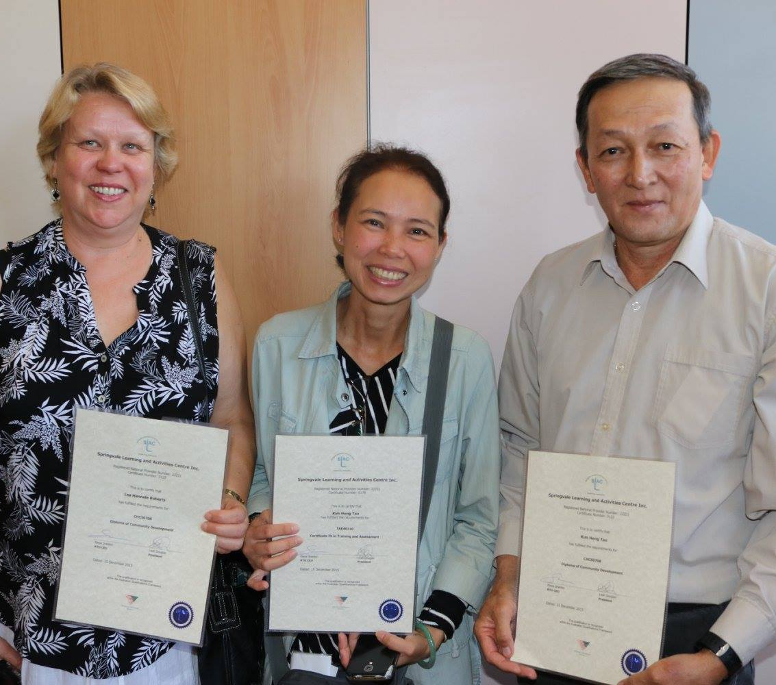
Vocational Courses
Early Childhood Education
Hospitality
Bookkeeping
Medical Reception
Office Skills
Business Administration
Customer Service
Aged Care
Community Services
First Aid / CPR
Community Development
Notes:
The data collected on your Neighbourhood House as part of the Participant Survey/Census in 2013 on benefits and outcomes should be inserted in this slide.

Slide 12
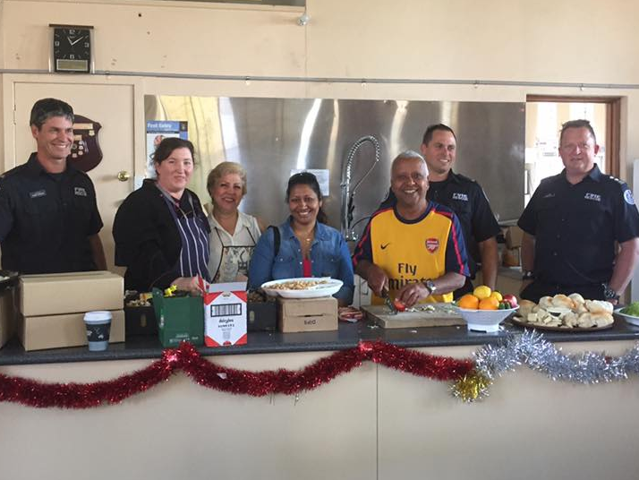
Community Groups
93 different community groups use rooms at City of Greater Dandenong Neighbourhood Houses
65 groups are supported by City of Greater Dandenong Neighbourhood Houses
[insert
number]
18 groups are auspiced by City of Greater Dandenong Neighbourhood Houses
Notes:
The data collected through the Neighbourhood House Survey should be inserted into this slide.

Slide 13
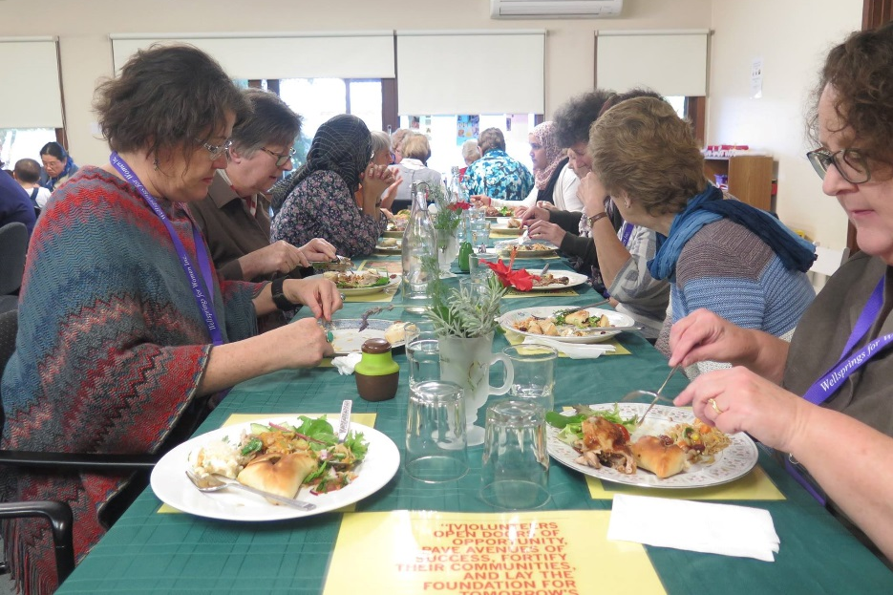
Community Services
Op Shop
Emergency Relief & Material Aid (3)
Family violence support
Asylum seeker support
Community Visitors (aged care)
Community Lunches
Dept Justice - Corrections Program
Volunteer one-to-one English tutors
Career Advice Service
Women’s Mentor program
Notes:
The data collected on your Neighbourhood House as part of the Participant Survey/Census in 2013 on benefits and outcomes should be inserted in this slide.

Slide 14
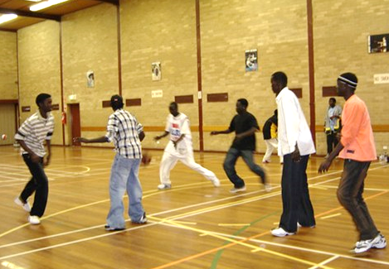
Community Spaces
Men’s Sheds (2)
Annual Arts Show
Harmony Festival
Indoor Basketball
Community Gardens
Health Expo
FreeMart
Sharing Freeway
Home Grown Produce Swap
Notes:
The data collected on your Neighbourhood House as part of the Participant Survey/Census in 2013 on benefits and outcomes should be inserted in this slide.

Slide 15
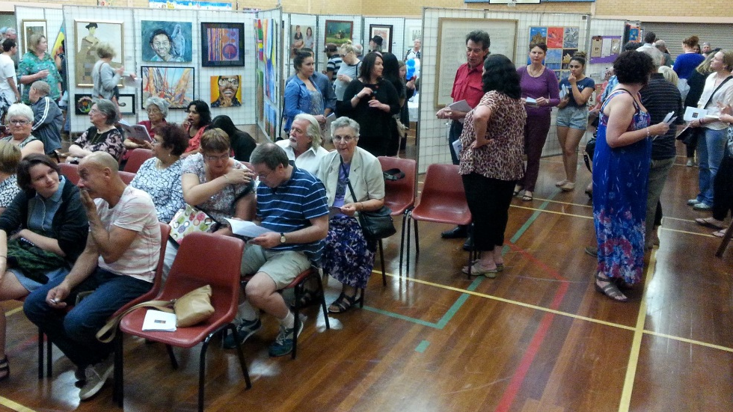
Partnerships
17 Educational
14 Community
4 Business
4 Government
2 Employment
Notes:
The data collected on your Neighbourhood House as part of the Participant Survey/Census in 2013 on benefits and outcomes should be inserted in this slide.

Slide 16
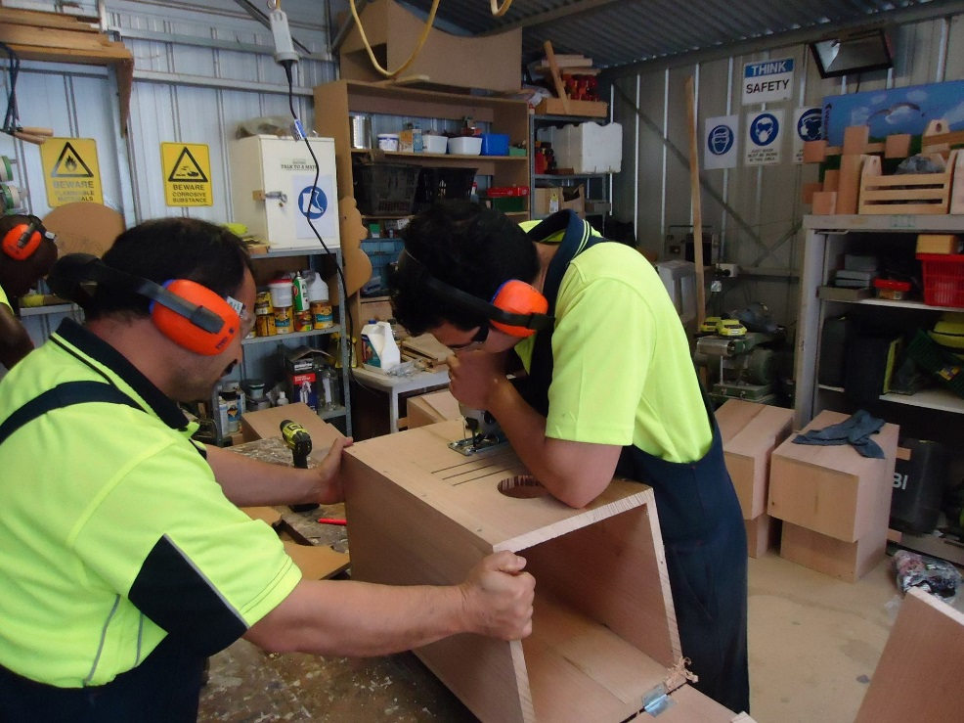
Network Partnerships
Learn Local Automotive Supply Chain Initiative
Asylum Seeker Learning Plan
Asylum Seeker Every Day English
Digital Literacy for Older People
Integrated Learning Links - Literacy Cluster
Notes:
The data collected on your Neighbourhood House as part of the Participant Survey/Census in 2013 on benefits and outcomes should be inserted in this slide.

